Slide 1


ABC Hospital Cloud Architecture Presentation
Shulika Lilian Tata., PhD
AWS SAP| AWS SAA| SAFe 5.0| MA PP| MA DIP|MA IR

Slide 2

AGENDA
Introduction
Purpose/Impact
Key Stakeholders
Business Value
Project Roadmap
Hospital architecture design
Challenge
Conclusion
Questions

Slide 3





Formerly a Cameroonian Diplomat
Agile delivery lead
A solutions Architect
An Author
A volunteer for WIRFON Cloud and Cloud Heroes Africa
An AWS community Lead
And many more…(This part is a bonus for when I get hired)
Hospital Architecture

Slide 4

Key stakeholders and Engagement models
Internal
Account executives
Sales personnel
Cloud architects
Data scientist
Cloud Project delivery managers
External
Contracting Client (Company ABC)
Project management team
Managing energy delivery systems
CRM tool management team

Slide 5
Key stakeholders and Engagement models
Internal
External
Account executives
Sales personnel
Cloud architects
Data scientist
Cloud Project delivery managers
Contracting Client (Company ABC)
Project management team
Managing energy delivery systems
CRM tool management team

Slide 6

Business Value/Impact
Increased Revenue by 27% (Company ABC 2022 report)
Decrease security incidents by 67% (Company ABC 2022 report)
Decrease operational Expenses by (CapEx vs Opex)
Governance, Regulatory, Compliance (GRC) HIPAA COMPLIANCE
Decreased downtime

Slide 7
Key Considerations Well architected Framework
Budget /Cost
Resources
Duration
Management Model
Business Value Migration Methodology workshops
Partner conference keynotes and breakout sessions

Slide 8
Timelines
Planning
-Sizing
-Prerequisites
PI - 1/2
Implementation
- Deployment
- Best practices
PI – 3/4
Validation
- Dry run
- Final Migration (cutover)
PI – 5/6
Post Go live
- Stability
-Ongoing support
PI -7/8/9
Timeline - 9-10 months
Delivery model – Agile methodology

Slide 9
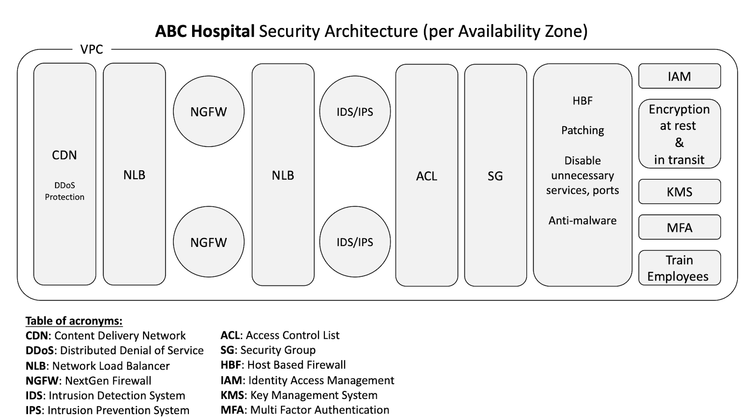
Hospital Architecture

Slide 10
ABC Hospital 3 Apps Architecture
VPC
Auto Scaling Group
Queue
Cache
SQL Database
Read Replica
Object
Storage
Immutable
7 years retention
Network
Load Balancer
Electronic Healthcare
5 VM
Domain Name Service
(DNS)
Content Delivery Network
(CDN)
NLB
Read Replica
Auto Scaling Group
Order Entry System
5 VM
Read Replica
NLB
Read Replica
Auto Scaling Group
Chats
VM
No SQL Database
NLB
Notes:
NLB – improves performane ang eliminates single points of failure
Web tier will be public facing, App(Logic) and DB tier will be private sbnets
The queue helps to smooth write traffic from the apps to the DB, no messages are lost
an apache Kafka queue can be used as it is cloud agnostic

Slide 11
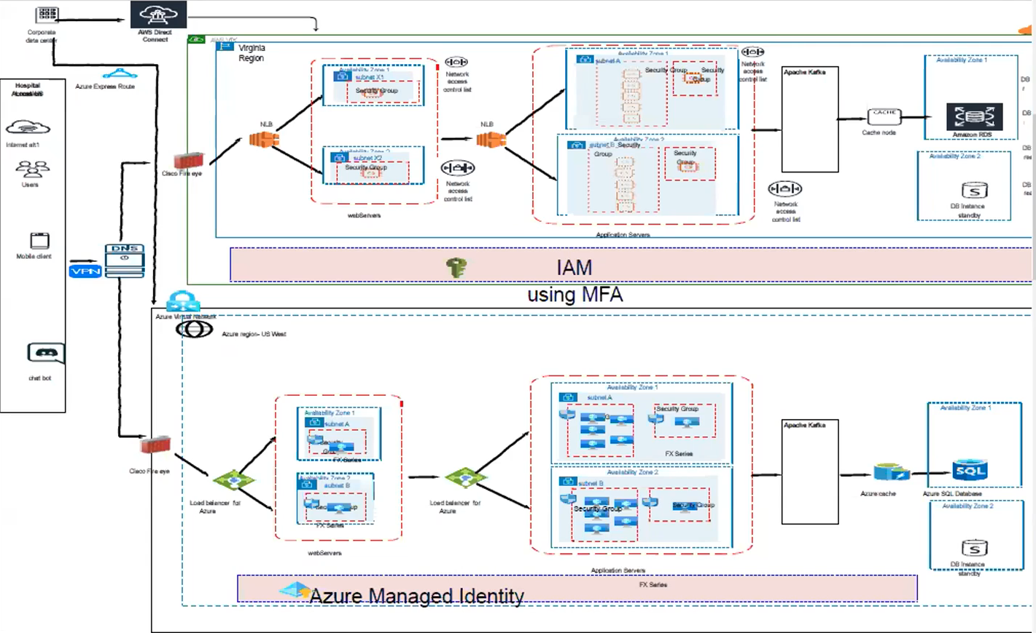
Hospital Architecture

Slide 12
Challenges
Unrealistic expectations
Tight timelines
Complex system
Right amount of resources
Strict security and compliance

Slide 13

Lessons learned
Spend more time on requirements gathering and analysis.
communicating with stakeholders and preparing them for the changes.
Under-estimated the impact this would have on the company's employees and operations.
Emphasis on testing and validation

Slide 14

Questions

Slide 15

Thank you!

